Slide 1
Decision Trees

Slide 2
Introduction to a new but familiar approach
Tree-based methods are used for numerical prediction and classification.
They involve stratifying or segmenting the feature space into a number of simple regions. In order to make a prediction for a given observation, we typically use the mean or the mode of the training observations in the region to which it belongs (for numerical prediction)
Just like we have seen before in LDA and Naive Bayes.
Since the set of splitting rules used to segment the predictor space can be summarized in a tree, these types of approaches are known as decision tree methods

Slide 3
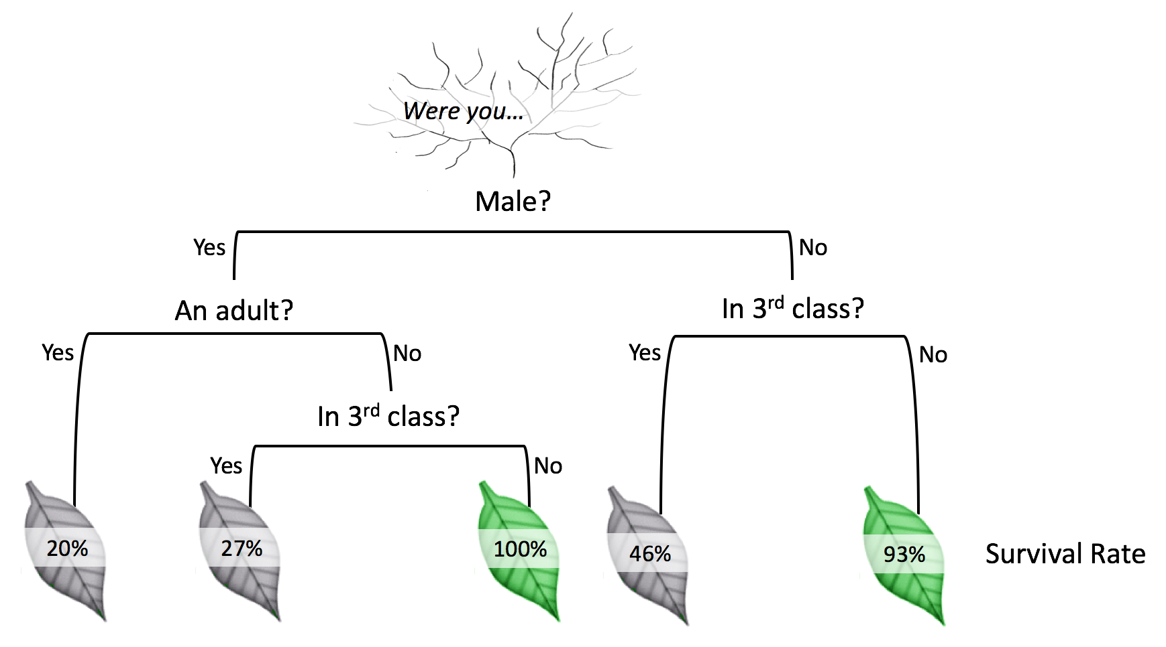
Example of a portion of the Titanic Decision Tree
Root Node
Internal or split node
Terminal or leaf node

Slide 4
Decision Trees: Broad Approach using Hitters data
So we want to predict the salary of a baseball player based on hits and years of experience.
This is how the approach of building a decision regression tree would start.
We divide the predictor space—that is, the set of possible values for X₁, X₂, . . . , X_{p}—into J distinct and non-overlapping regions, R₁,R₂,...,R_{J}.
For every observation that falls into the region R_{j} , we make the same prediction, which is simply the mean of the response values for the training observations in R_{j}.

Slide 5

How to divide the predictor space?
These regions R_{J}, could be any shape but as rectangles or boxes, they are quite easy to interpret.
The goal is to find boxes R₁, . . . , R_{J} that minimize the RSS, given by
Where yˆ_{Rj} where is the mean for the training observations in the j^{th} box.
But on what basis do we partition our feature space into boxes? Where do we draw the boundaries?

Slide 6
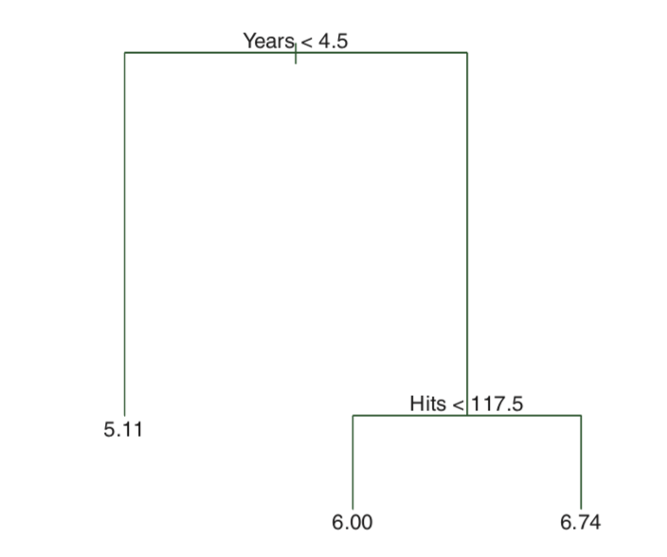
How to divide the predictor space?

Slide 7
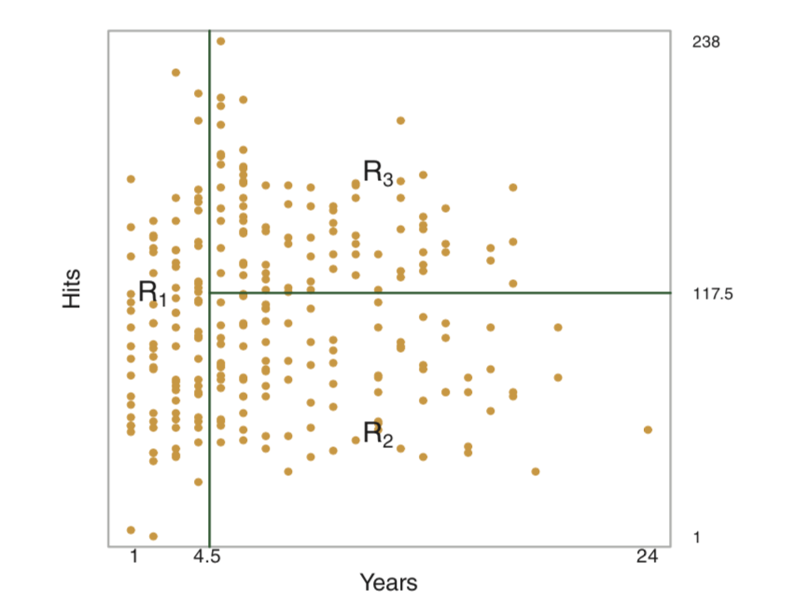
How to divide the predictor space?

Slide 8
Decision Trees: A greedy algorithm
To make partitions, Decision Trees engage in a process of recursive binary splitting .
At first, we consider the feature space as a whole and then successively split the predictor space; each split is indicated via two new branches further down on the tree.
This approach is called greedy because the best split is made at that particular step, rather than looking ahead and picking a split that will lead to a better tree in some future step.
So, we first select the predictor X_{j} and the cutpoint s such that splitting the predictor space into the regions {X|X_{j} < s} and {X|X_{j} ≥ s} leads to the greatest reduction in RSS.
Notes:
Assume that you have an objective function that needs to be optimized (either maximized or minimized) at a given point. A Greedy algorithm makes greedy choices at each step to ensure that the objective function is optimized. The Greedy algorithm has only one shot to compute the optimal solution so that it never goes back and reverses the decision.

Slide 9

Decision Trees
So, we seek values for j and s that minimize the objective function of:
Next, we repeat the process, looking for the best predictor and best cut point in order to split the data further so as to minimize the RSS within each of the resulting regions. However, this time, instead of splitting the entire predictor space, we split one of the two previously identified regions.
Again, we look to split one of these three regions further, so as to minimize the RSS. The process continues until a stopping criterion is reached; for instance, we may continue until no region contains more than five observations.

Slide 10
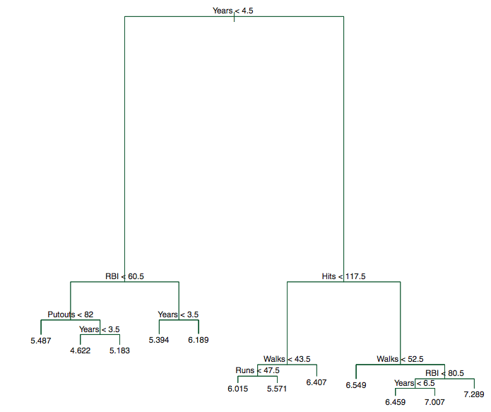

Slide 11
Classification Trees
So, for a regression tree, the predicted response for an observation is given by the mean response of the training observations that belong to the same terminal node.
In contrast, for a classification tree, we predict that each observation belongs to the most commonly occurring class of training observations in the region to which it belongs.
We also undertake recursive binary splitting here, but the split is considered best not with respect to RSS, but with a classification error rate.
Let us consider some ways to capture error.

Slide 12
Deciding how to split
Let’s say we have 30 students with certain features, who all either did or not attend Byte (Target). Now I will try and make a decision tree to understand which features are most associate with the decision to come to Byte. The features are gender, CS Degree and type of laptop.
Which variable should I split on? We want the most homogenous node with the most probability of one class. We can measure the homogeneity using the Gini Index.

Slide 13
Important Hyperparameters
min_samples_split: This tells above the minimum no. of samples reqd. to split an internal/decision node. If an integer value is taken then consider min_samples_split as the minimum no. If float, then it shows percentage. By default, it takes “2” value. min_samples_leaf: The minimum number of samples required to be at a leaf node. If an integer value is taken then consider min_samples_leaf as the minimum no. If float, then it shows percentage. By default, it takes “1” value. max_leaf_nodes: It defines the maximum number of possible leaf nodes. If None then it takes an unlimited number of leaf nodes. By default, it takes “None” value.
Notes:
. If None, then nodes are expanded until all leaves are pure

